Slide 1
ARSENIC
DR.S.SANJU
ASSISTANT PROFESSOR
FORENSIC MEDICINE & TOXICOLOGY

Slide 2
ARSENIC -ACTION
Interferes with cellular respiration by combining with the sulphydryl group of mitochondrial enzymes ,especially pyruvate oxidase and certain phosphatases. Its particular target is vascular endothelium, leading to increased permeability ,tissue oedema and haemorrhage, especially in intestinal canal. It uncouples the mitochondrial oxidative phosphorylation & interferes with glycolysis

Slide 3
SIGNS AND SYMPTOMS
1.THE FULMINANT TYPE.
2.THE GASTROENTERIC TYPE.
3.NARCOTIC FORM

Slide 4
FULMINANT TYPE
Massive doses(3-5gm) causes death in 1 to 3 hrs from shock and peripheral vascular failure. All the capillaries are markedly dilated with a marked fall of blood pressure. It also has a direct action on heart muscle. In this type gastrointestinal symptoms are absent

Slide 5
GASTROENTERIC TYPE
Common form and resembles bacterial food poisoning. symptoms usually appear half to one hour after ingestion, but may be delayed many hrs especially when arsenic is taken with food. There is sweetish metallic taste.

Slide 6
GASTROENTERIC TYPE
G.I.T: Constriction in throat and difficulty in swallowing; burning and colicky pain in oesophagus ,stomach and bowel occur. intense thirst and severe vomitting which may be projectile are the constant symptoms. Purging (within 1 to 3 hrs) is usually accompanied by tenesmus ,pain and irritation about the anus.

Slide 7
GASTROENTERIC TYPE
G.I.T: The stools are expelled frequently and involuntarily and are dark coloured stinking and bloody, but later become colourless ,odourless and watery resembling rice water stools of cholera. A garlicky odour of breath and faeces may be noted.

Slide 8
GASTROENTERIC TYPE
HEPATIC – Fatty infiltration
RENAL – Oliguria,uraemia; urine contains albumen,red cells and casts,pain during micturition.
C.V.S – Acute circulatory collapse with vasodilation , increased vascular permeability, ventricular tachycardia, ventricular fibrillation.

Slide 9
GASTROENTERIC TYPE
C.N.S- Headache,vertigo,hyperthermia,tremors,convulsions,coma,general paralysis.A peripheral neuropathy that is more sensory than motor can occur in assymmetric distal-glove distribuion after 1 to 2 weeks of acute or chronic exposures.
SKIN- Delayed loss of hair,skin eruptions. Death is usually due to circulatory failure

Slide 10
NARCOTIC FORM
Giddiness, formication and tenderness the muscles, delirium,coma and death.
Late sequelae of acute exposure include haematuria and acute tuybular necrosis. Anaemia ,leucopaenia and thrombocytopaenia can occur

Slide 11
DIFFERENCE BW ARSENIC POISONING & CHOLERA
TRAIT | ARSENIC POISONING | CHOLERA
PAIN IN THROAT | Before vomitting | After vomitting
PURGING | After vomitting | Before vomitting
STOOLS | Dark coloured and bloody, later rice watery | Rice watery ,not bloody and passed in continuous involuntary jet
TENESMUS AND ANAL IRRITATION | present | Absent
VOMITTED MATTER | Contains mucus,bile and blood | Watery without mucus,bileand blood

Slide 12
DIFFERENCE BW ARSENIC POISONING & CHOLERA
TRAIT | ARSENIC POISONING | CHOLERA
VOICE | Not affected | Rough and whistling
CONJUNCTIVA | inflamed | Not inflamed
ANALYSIS OF EXCRETA | Arsenic present | Cholera vibrio present
CIRCUMSTANTIAL EVIDENCE | Of arsenic poisoning may be present | Other cases of cholera in locality

Slide 13
FD,FP
FATAL DOSE : 0.1 TO O.2 G Arsenic trioxide
FATAL PERIOD : One to two days

Slide 14
ARSENIC POISONING
A- Aldrich Mees line.
R – Rice water stool, Red velvet.
S – Sound clear, Subendocardial haemorrhage.
E – Emetics not recommended.
N – Neuropathy.
I – Inflammed conjunctiva, Icteric.
C – Circulatory collapse, Convulsions

Slide 15
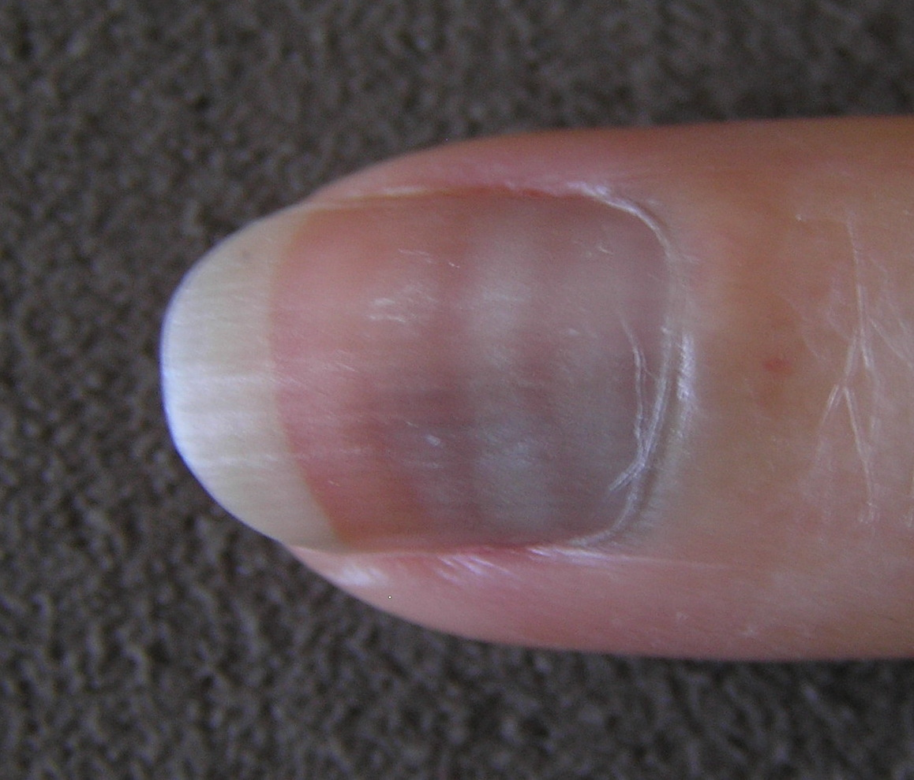
CHRONIC POISONING

Slide 16
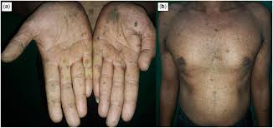
RAIN DROP

Slide 17
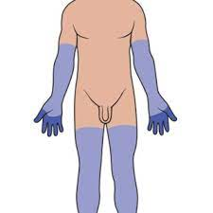
STOCKING - GLOVES

Slide 18
MERCURY (QUICK SILVER)
Mercuric –soluble and poisonous
OXIDE,CHLORIDE,IODIDE,CYNIDE,SULPHIDE
Mercurious –less soluble and less active.
ACTION – Binds with sulphydryl groups of enzymes and cellular proteins ,nucleic acids and mitotic apparatus interfering with enzyme and cellular transport functions.

Slide 19
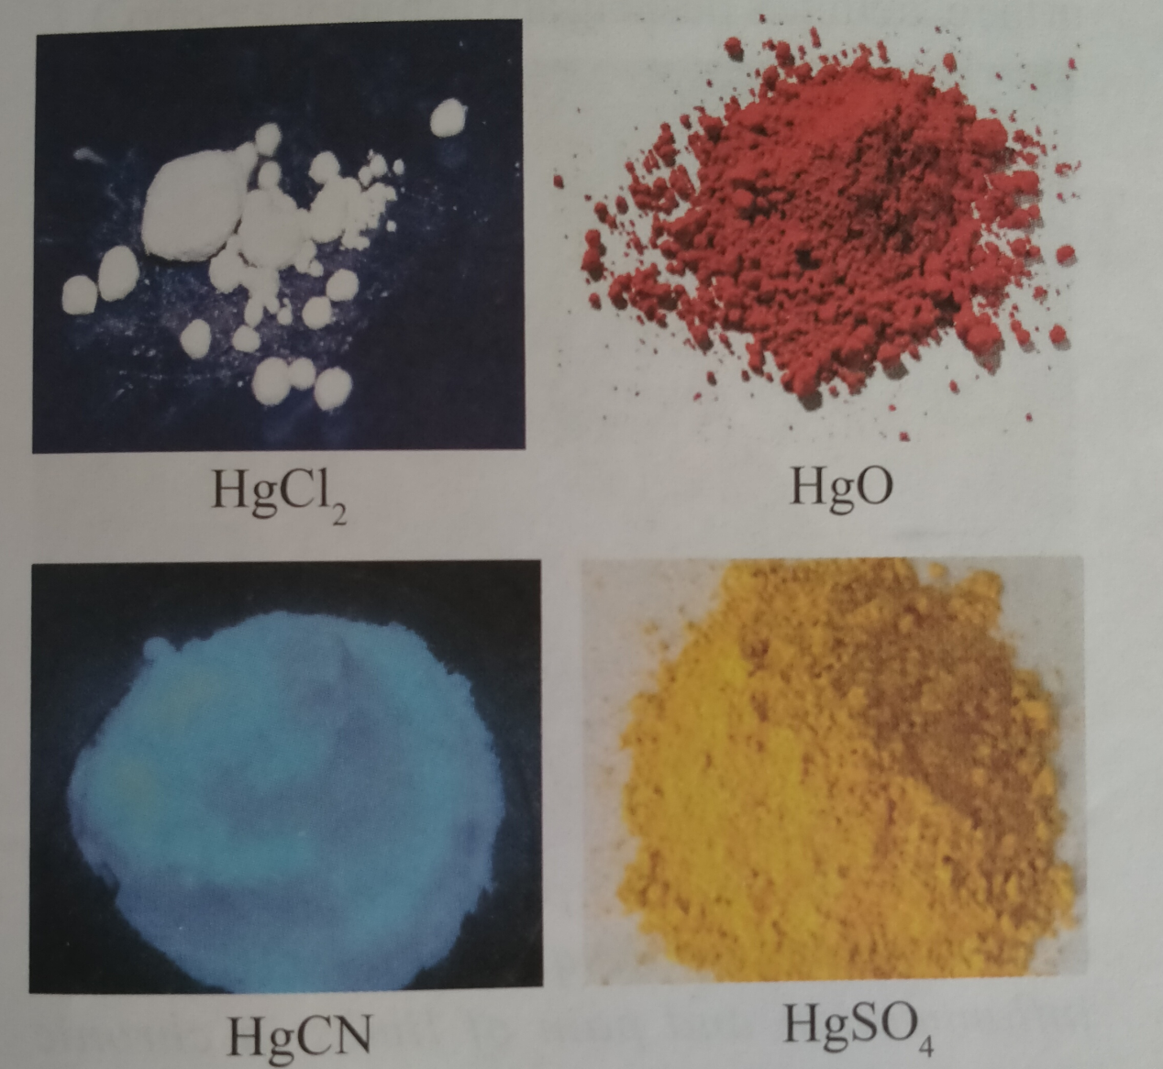
mercury

Slide 20
SYMPTOMS OF MERCURY- first phase
Acrid metallic taste, constriction in throat, mouth corroded and has greyish white coating. Vomit contains greyish slimy mucoid material with blood and shreds of mucous membrane, followed by diarhoea. CIRCULATORY COLLAPSE occurs.
Inhalation of fumes produce nervous symptoms,e.g.ataxia,restriction of visual field,paresis and delirium.

Slide 21
SYMPTOMS OF MERCURY-
SECOND phase
If the person survives ,second phase begins in 1 to 3 days. Glossitis and ulcerative gingivitis ,severe infection, loosening of teeth and necrosis of jaw. necrosis of renal tubules.
INTRAMUSCULAR injection produces abscess with ulceration.
IV injection may cause mercurialism in which thrombophlebitis, granuloma formation, pulmonary embolism and haemoptysis

Slide 22
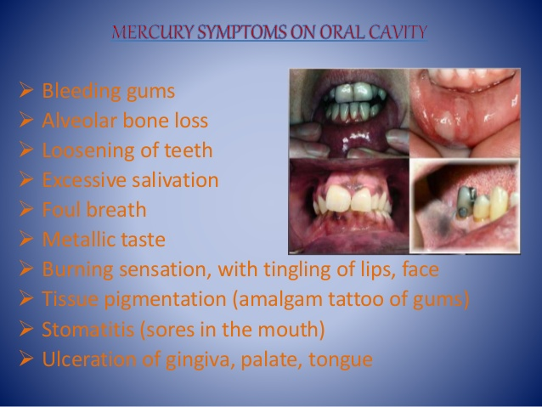
mERCURY

Slide 23
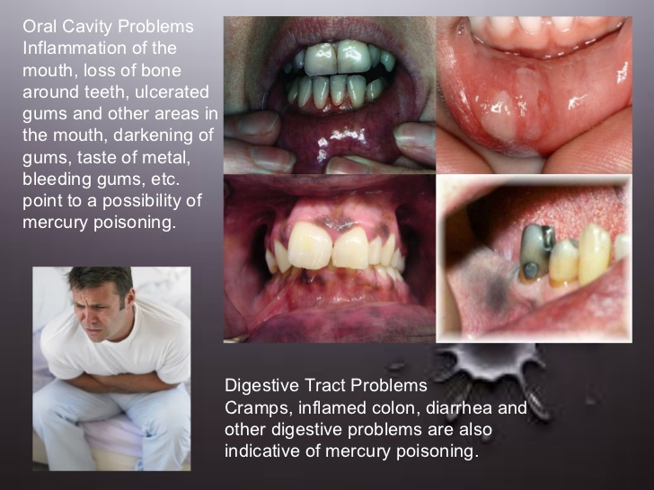
mercury

Slide 24
TREATMENT
Gastric lavage
Pencillamine
BAL
NR
Ca-EDTA
cathartics

Slide 25
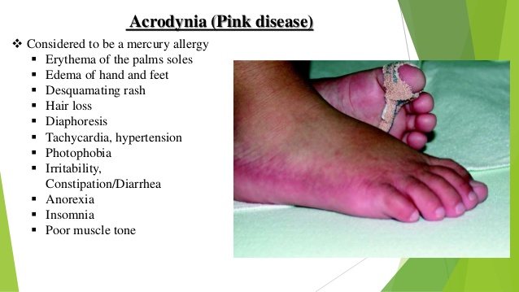
ACRODYNIA

Slide 26
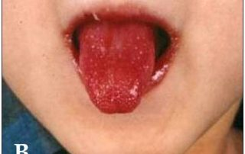
MERCURY POISONING

Slide 27
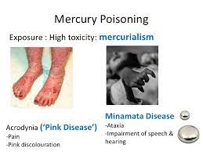
mercury

Slide 28
mercury

Slide 29
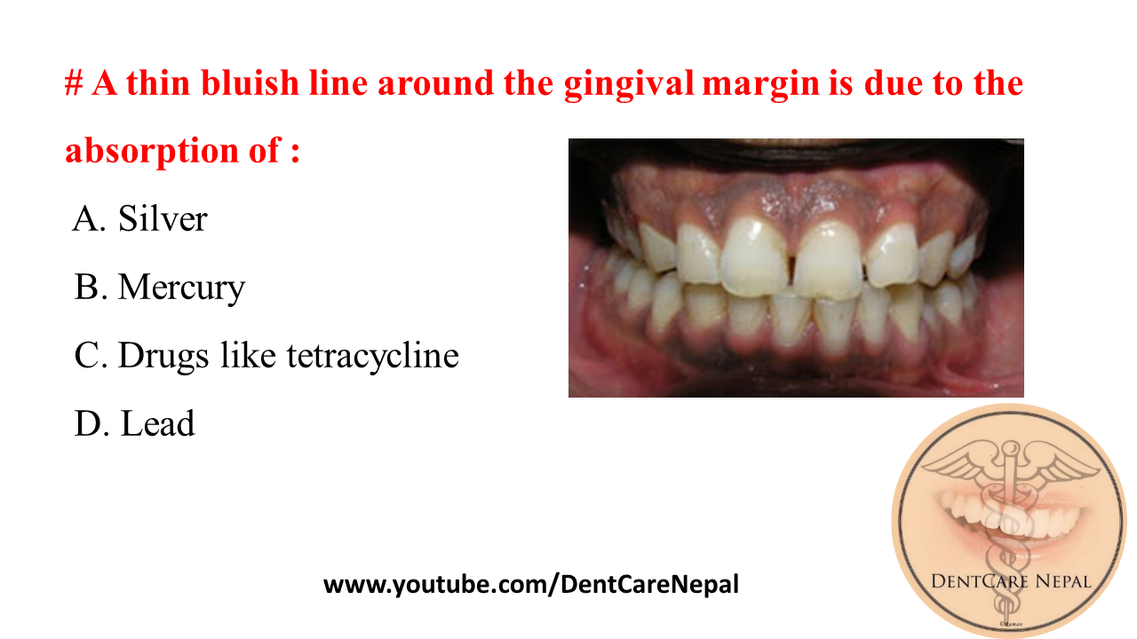
Burtonian line

Slide 31
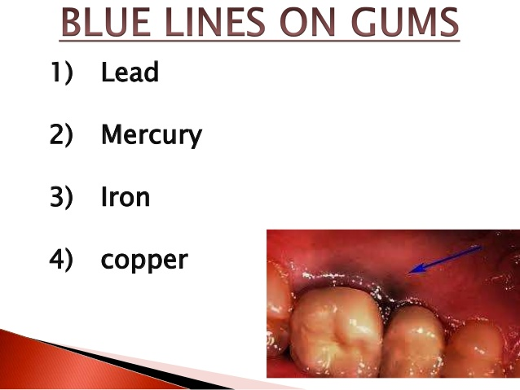

Slide 32
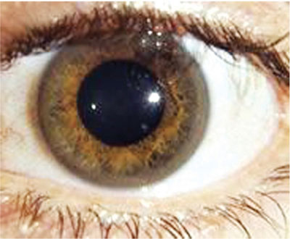
MERCURIA LENTIS

Slide 33
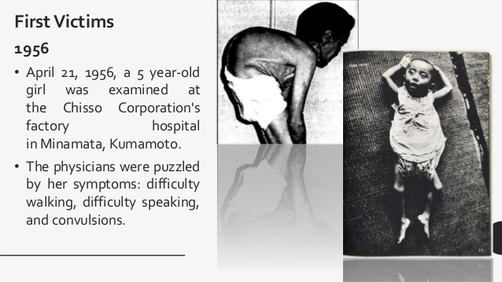
MINIMATA BAY DISEASE

Slide 34
MINIMATA BAY DISEASE
Chronic poisoning of methyl mercury.
Caused by contaminated fish from minimata bay.
Disturbances in hand coordination,gait and speech.
Difficulty in chewing and swallowing.
Tremors,blurring of vision,cloouding of consciouness aand seizures

Slide 35
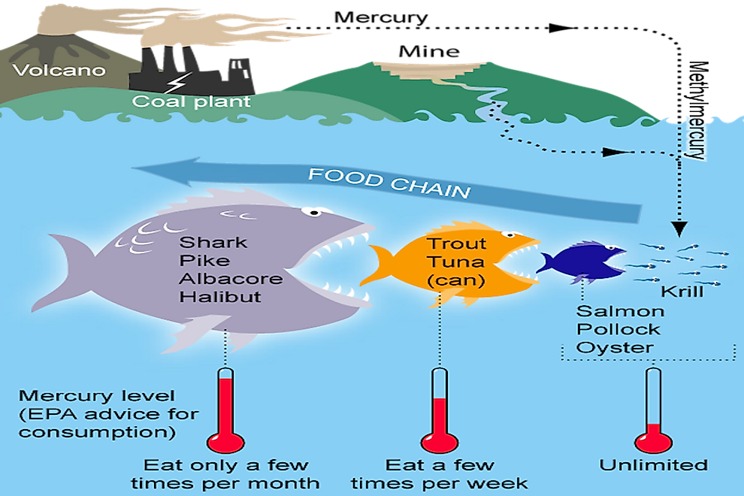
MINIMATA- TRANSMISSION

Slide 36
LEAD
Heavy steel grey metal
The principal salts - lead acetate-White
carbonate-white
chromate-bright yellow
monoxide-brick red
tetroxide-scarlet
Used in storage batteries, solders, paints, hair dyes,electric cable insulations,pottery and ceramics and petrol

Slide 37
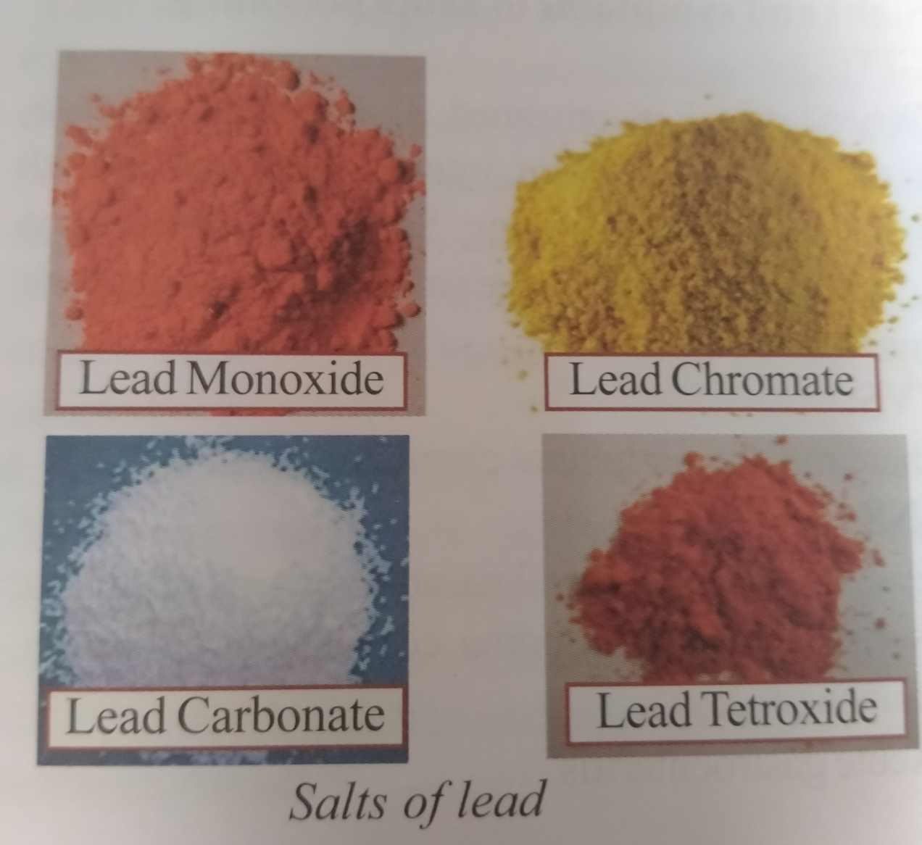
SALTS OF LEAD

Slide 38
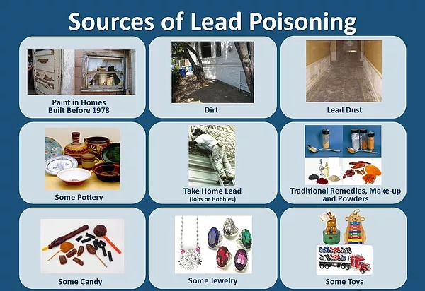
SOURCES OF LEAD POISONING

Slide 39
ACUTE POISONING
Astringent and metallic taste,dry throat, thirst, burning abdominal pain, nausea, vomitting, sometimes diarrhoea, peripheral circulatory collapse, headache , insomnia, parasthesia, depression, coma and death.
Cerebellar ataxia is common in children

Slide 40
ACTION
Interacts with sulphydryl group and interferes with action of enzymes necessary for haem synthesis. Interferes with mitochondrial oxidative phosphorylation, ATPases, calcium dependent messengers and enhances oxidation and cell aoptosis.causes haemolysis.
FD-About 20g.lead acetate;40g lead carbonate
FP- 1 TO 2 DAYS

Slide 41
TREATMENT
Gastric lavage
Demulcents
Combination of B.A.L and calcium disodium versenate or DMSA
Pencillamine
Peritonial or haemodialysis

Slide 42
Chronic (plumbism;saturnism)
CAUSES- Inhalation of lead dust and fumes.
continuous absorption from drinking water
absorption through raw or intact skin
use of food stored in tin.
from toys and furniture
CHRONIC POISONING RESULTS FROM DAILY INTAKE OF 1 TO 2 MG OF LEAD

Slide 43
Chronic (plumbism;saturnism)
1.FACIAL PALLOR
2.ANAEMIA
3.LEAD LINE
4.COLIC AND CONSTIPATION
5.LEAD PALSY
6.ENCEPHALOPATHY
7.CARDIOVASCULAR SYSTEM AND KIDNEYS
8.REPRODUCTIVE SYSTEM
9.OTHER SYSTEMS

Slide 44
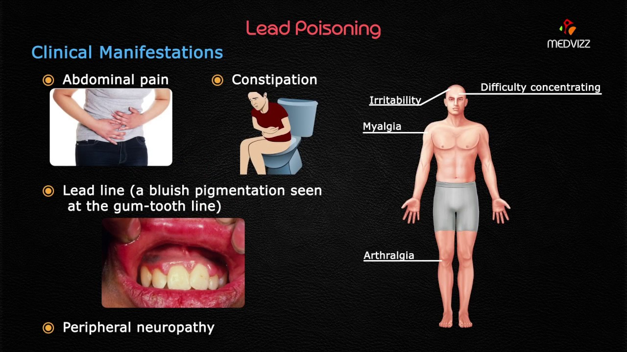
PLUMBISM

Slide 45
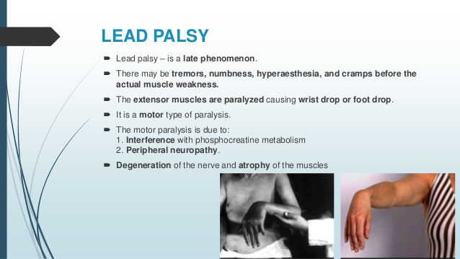
LEAD PALSY

Slide 46
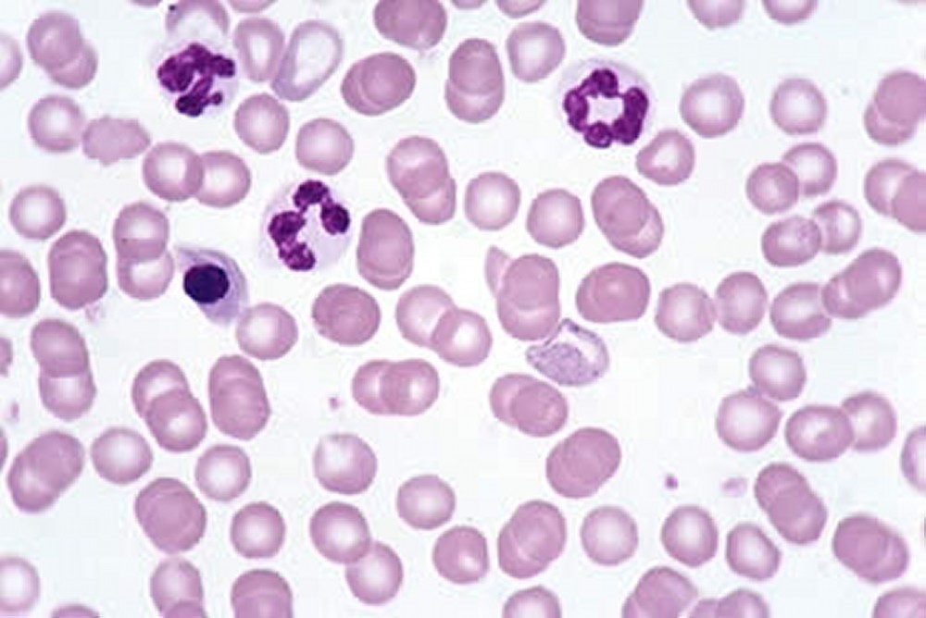
BASOPHILC STIPPLING

Slide 47
ABCDEFGHI of lead
A – Anaemia,Anorexia,Amenorrhea,Abortion, Aminolaevulinic acid in urine
B – Basophilic stippling,Burtonian line.
C – Cabot’s ring, Colic,Constipation,
Coproporphyrin in urine
D – Drops(wrist,foot),Dyspepsia.
E – Encephalopathy,Eosinophilia.
F – Foul breath,Facial pallor,failure kidney
G - Gonadal dysfunction.
H - Hypertension,Hallucination, Hyperaesthesia.
I - Impotence,Infertility,Insomnia,

Slide 48
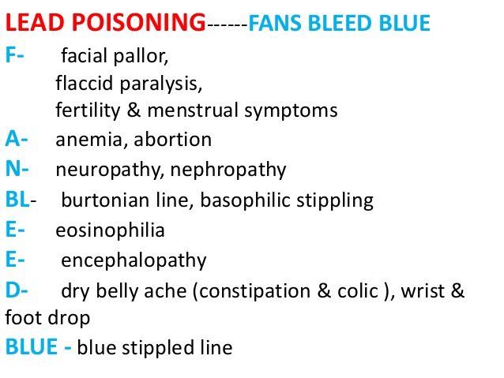

Slide 49
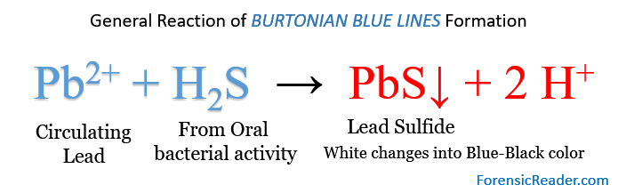
Burtonian blue line

Slide 50
Plumbism
Pallor
Polychromatophilia
Polychromasia
Punctate basophilia(pin head)
Poikilocytosis
Porphyrin metabolism interference
Palsy
Porphyrinuria
PAS – Positive ,pink staining in perivascular space in brain.

Slide 51
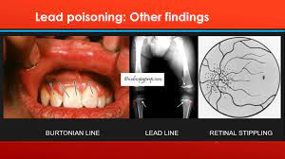
RETINAL STIPPLING

Slide 52
DIAGNOSIS
1.History
2.Clinical features.
3.Laboratory tests a.Coproporphyrin in urine
b.Aminolaevulinic acid .
c.25µg/100ml of blood.
d.0.25 mg /lt of urine.
e.Basophilic stippling.
4.X ray –a. increase radio opaque bands or lines at metaphyses of long bones and along margins of iliac crest in children.
b. radio opaque material in GIT.

Slide 53
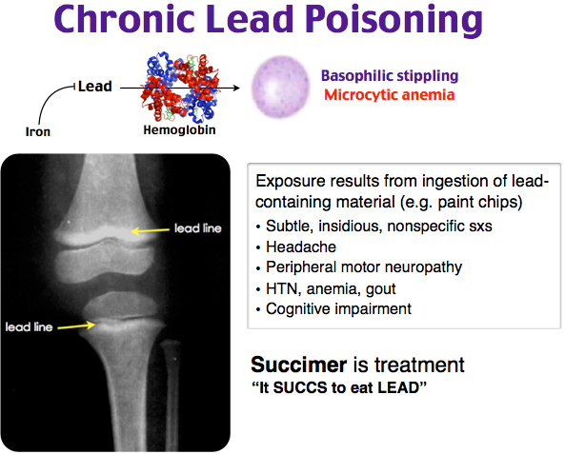
X ray findings

Slide 54
TREATMENT
(A) SEVERE ACUTE POISONING WITH ENCEPHALOPATHY
(B) SEVERE POISONING WITH OUT ENCEPHALOPATHY(Morethan70µg /100ml)
(C) MODERATE POISONING(45 TO 75)
(D) MILD POISONING(20 TO 35)
(A) and (B)-BAL,EDTA AND CHELATION.
(C) – EDTA.
(D) – D-pencillamine.

Slide 55
POSTMORTEM APPEARANCE
Blue line,
Paralysed muscles show fatty degeneration.
GIT- Ulcerative or haemorrhagic changes and contracted and thickened.
Liver and kidneys – contracted and presence of eosinophilic intranuclear inclusions in cells.
Brain – very pale and swollen.PAS – positive ,pink staining ,homogenous material may be seen in perivascular spaces.
Heart – hypertrophied and atheroma of aorta and aortic valves.
Bone marrow – hyperplasia of leucoblasts and erythroblasts.

Slide 56
CAUSE OF DEATH
ACUTE – gastroenteritis and subsequent shock.
CHRONIC – malnutrition ,intercurrent infection, failure of liver function,respiratory failure,renal failure and encephalopathy

